Slide 1


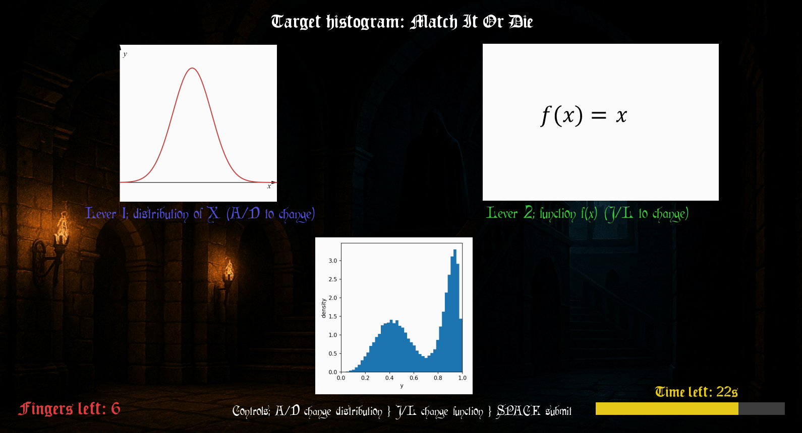





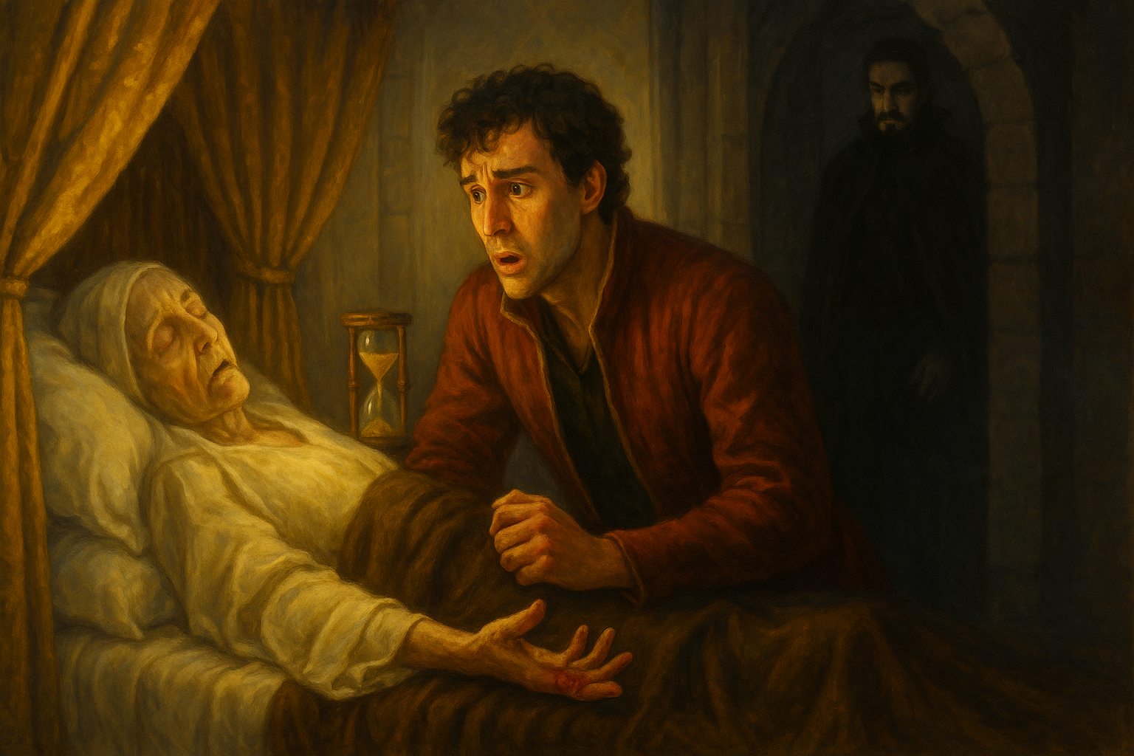
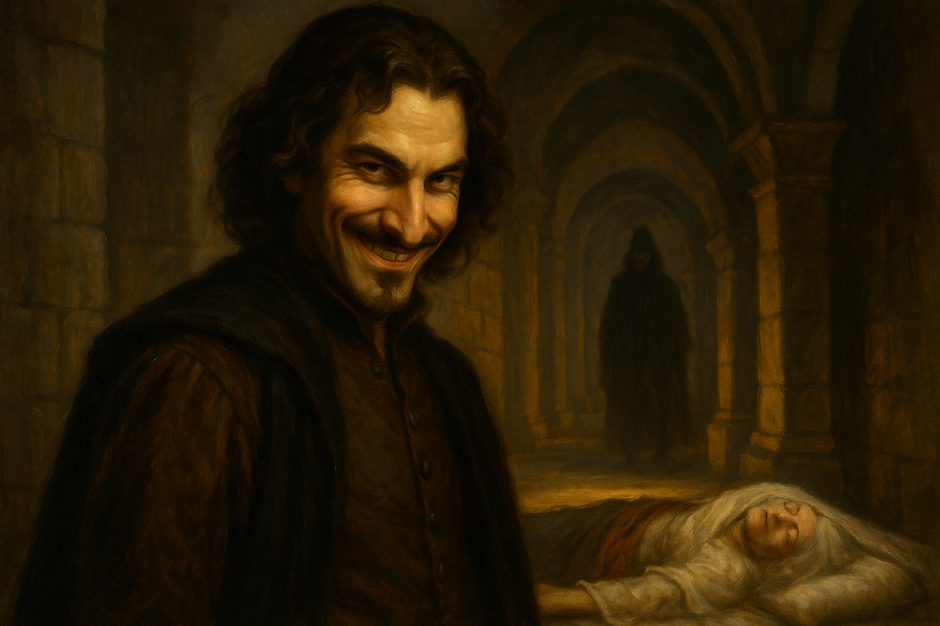
The Countdown of Conte Carlos
Group 8: Jericho Morallo and Finn Maguire
A Monte Carolo Style Puzzle Adventure Game
Match The Histogram. Beat The Clock. Keep Your Fingers.
Story Overview:
Carlos has one last chance to prove he is the true heir. He was exiled by his evil twin brother Iñigo after being blamed for causing their father's death years ago. Carlos has returned to see his mother who is on her deathbed. Her time is limited, and an hourglass of sand is going to determine her passing. Carlos must be recognized by her before that happens, otherwise, Inigo will take the throne. Each wrong guess costs a finger.
User Inputs:
To Cycle Through Distributions:
To Cycle Through Functions:
To Submit Guess:
Match the target histogram by choosing the correct distribution of X and the correct transformation f(x). Each wrong guess costs a finger.
Can Carlos prove he is the true heir or will his evil twin Iñigo claim the throne?

